Slide 1
Optimal Selection of ATE Frequencies for Test Time Reduction Using Aperiodic Clock
Sindhu Gunasekar
Vishwani D. Agrawal
Notes:
The slide guide is available in the following file:
slidesV16.2.ppt: PowerPoint, version 2003 format.
Note: We have saved this presentation in the older 2003 format, because PowerPoint 2003, 2007 and 2010 can read it.
For this year’s test conference we will use PowerPoint 2007 in our projection computers.

Slide 2
Overview
Background
Problem Statement
Algorithm & Implementation
Results
Conclusion
Notes:
View it as a slide show first. It will highlight important aspects of your presentation, and give you an example of a presentation that lives up to ITC presentation standards and guidelines.
Virus checker: When we created this presentation guide it contained no known viruses. This file was checked by current anti-virus software before being distributed to authors. You should use a good, up to date virus checker on this file, and any other file you import from an outside source. Make sure your virus checker’s data files are up to date, too. Keep in mind: the version of this file you are reading may be different from the version we checked!
Confidentiality: We respect your copyright, and do not distribute your presentation before the conference. However, we cannot promise strict confidentiality of your presentation before the conference, because others have read access to our FTP sites. Do not include confidential information in your presentation.
Test Slide: A test slide is included as a “hidden slide” after the end of this presentation. If you want to do a trial projection, ensure that your projector projects the entire slide, and that aspect ratios are correct. We will use the same test slide at the conference for setup of our projection equipment.

Slide 3
Background - Aperiodic clock test
Each clock interval can be either structure constrained or power constrained, i.e.,
$$Ti=\max{\{T_{STRUCTURE}, \frac{Ei}{PMAXfunc}\}}$$
where,
T_{i} is the clock interval of each test cycle
E_{i} is the energy dissipated by each cycle
Each cycle may not use exactly the same period as its neighboring cycle
For a given voltage, aperiodic test runs faster than the periodic clock test

Slide 4
Problem Statement
Aperiodic clock reduces test time
Ideal:
for a test that is n cycles long, the test time is minimum when the CUT is tested with n different frequencies
Reality:
The ATE generates only a limited number of frequencies
n different frequencies may not be necessary to achieve maximum reduction in test time
Algorithm to determine an optimum set of frequencies is needed

Slide 5
The Optimisation Problem
Total Test Time = ∑^{k}_{i=1} n_{i} t_{i} where n_{i} is number of cycles at the period t_{i}
k is the number of different frequencies the ATE allows
t_{i} has to be determined
Notes:
combinatorial optimization is a topic that consists of finding an optimal object from a finite set of objects

Slide 6
The Optimisation Problem
Combinatorial optimisation problem in the discrete domain
NP-complete problem
Using heuristics the NP-complete problem is solved in polynomial-time to find near-optimal solutions

Slide 7
Greedy Algorithm
Locally optimal choice that looks best at each stage.
Does not always yield optimal solutions.
May yield locally optimal solutions that approximate a global optimal solution.
One optimum clock period is found by one iteration over all the n different clock intervals, to find which clock interval minimises the test time.
Subsequent clocks are found one at each step.
Clocks found at the previous step are unaltered.

Slide 8
Three other algorithms are implemented
Iterated Local Search
Directed Search
Simulated Annealing
Solutions obtained converge to the solutions of the greedy algorithm.

Slide 9
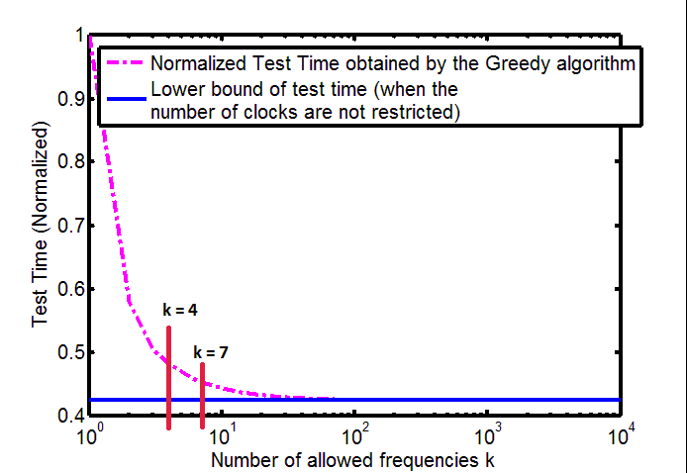
Normalised Test Time of s1238 obtained by the greedy algorithm

Slide 10
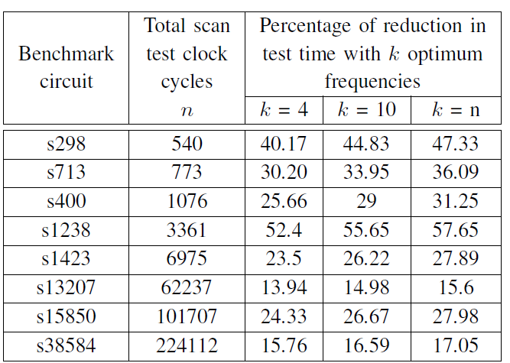
Percentage of Reduction in Test time of the ISCAS ‘89 benchmarks, with 4, 10 and n frequencies

Slide 11
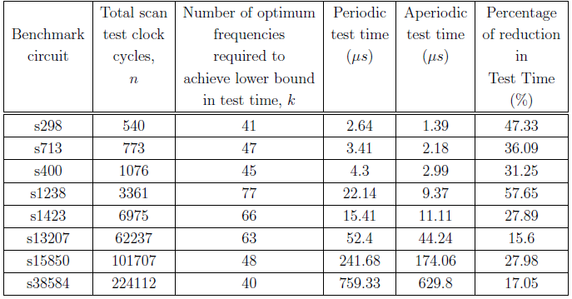
Lower bound in aperiodic test time obtained with the greedy algorithm by simulating ISCAS '89 benchmark circuits.

Slide 12
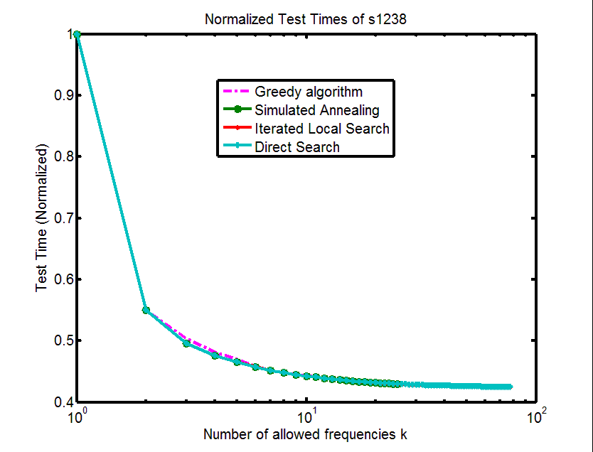
Normalised test time of the s1238 benchmark obtained through various algorithms

Slide 13
S298 tested on the ATE T2000GS which allows 4 different frequencies
 | Periodic clock | Aperiodic clock with arbitrary frequencies | Aperiodic clock with frequencies computed by the greedy algorithm
Test time (μs) | 270 | 184 | 158
Percentage of reduction in test time | 0 % | 31.85% | 41.48 %

Slide 14
Periodic clock test ATE result for 540-cycle scan test of s298 benchmark circuit showing test cycles 15 to 45 with a clock of 500ns.

Slide 15
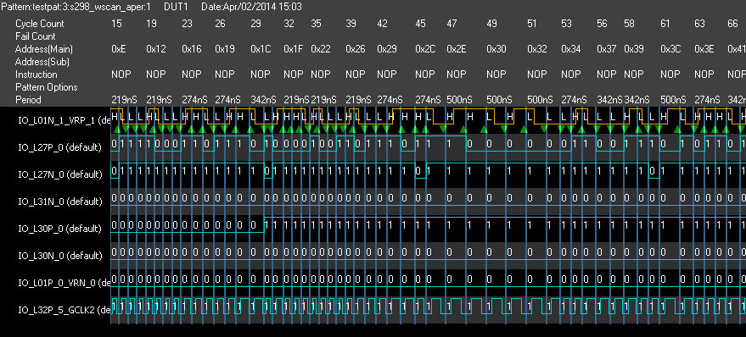
Aperiodic clock test ATE result for 540-cycle scan test of s298 benchmark circuit showing test cycles 15 to 66 with a clock periods of 219ns, 274ns, 342ns and 500ns.

Slide 16
Conclusion
The greedy algorithm to find optimum clock frequencies is proven to be as good as any of the other local search and global search algorithms.
As few as four frequencies can give a test time reduction up to 52% in a few circuits.
Computation time is of the order of milliseconds.
Ten clock frequencies are optimum for test time reduction for most of the benchmark circuits simulated in this work.

Slide 17
Future Work
The high costs of automatic test equipment (ATE) and the growing clock frequencies bring about the need to study on-chip clock generation circuitry for generation of aperiodic clocks
Can be implemented in BIST circuits where the test patterns are generated on-chip.

Slide 18
References
P. Venkataramani and V. D. Agrawal, “ATE Test Time Reduction Using Asynchronous Clocking,” in Proc. International Test Conf., Sept. 2013. Paper 15.3.
T. H. Cormen, C. E. Leiserson, R. L. Rivest, C. Stein, et al., Introduction to algorithms, volume 2. MIT press Cambridge, 2001.
P. Mangilipally and V. P. Nelson, “Emulation of Slave Serial Mode to Configure the Xilinx Spartan 3 XC3S50 FPGA Using Advantest T2000 Tester,” in Technical report, Auburn University, 2011.
P. Venkataramani, S. Sindia, and V. D. Agrawal, “Finding Best Voltage and Frequency to Shorten Power-Constrained Test Time,” in Proc. 31st IEEE VLSI Test Symp., Apr. 2013, pp.19-24.

Slide 19
THANK YOU

